Slide 1
Mathematical Foundation of Machine Learning
VI. Reinforcement Learning 1

Slide 2
Summary
So far, we have learned:
Model generalization:
trade off among training data size, model compacity and smoothness of NN
Optimization:
SGD with/out momentum, AdGrad, RMSProp, Yogi, AdBelief...
Deep Neural Network:
CNN, RNN, LSTM, Attention, Self-attention, Transformer, ...
Generative modeling:
VAE, GAN, Normalizing Flow...

Slide 3
Some Research topics
System Identification
Manifold learning
Learning dynamics for multiscale system
Learning nonlocal operator
Applications
- Feature representation
- Data Augmentation
- Data remediation
More on mathematical foundations for deep learning ...

Slide 4
Reinforcement learning Outline
ref. Book:
Richard S. Sutton, Andrew G. Barto: Refincement Learning:An introduction
Dimitri P. Bertsekas, reinforcement learning and optimal control
Introduction and comparison with optimal control
- Chapter 1 - 3: Introduction and Markov Decision Process
Value Based RL and Policy based RL
- Chapter 4 - 6: Dynamical Programing, Monte Carlo and TD Learning
- Chapter 9 - 11: On-policy, Off-policy, Actor-Critic
Frontiers of RL and Applications
- Connection between optimal control and RL
- Meta learning
- Multi-Agent Deep Reinforcement Learning
- Model-based learning

Slide 5
More learning resources:
Open source:
deepmind https://khipu.ai/program/ （Nando de Freitas） Video, Slides
MIT http://www.athenasc.com/dpbook.html
Berkeley http://rail.eecs.berkeley.edu/deeprlcourse/
CMU http://www.andrew.cmu.edu/course/10-703/
OpenAI SpinningUp https://github.com/openai/spinningup
https://www.zhihu.com/question/49230922
Introduction https://spinningup.openai.com/en/latest/spinningup/rl_intro.html
Deep RL Researcher https://spinningup.openai.com/en/latest/spinningup/spinningup.html

Slide 6
Outline for today
Introduction to Reinforcement Learning
Mathematical formulation of RL
Value-based learning, Policy Gradient and the combination
Connections with optimal control

Slide 7
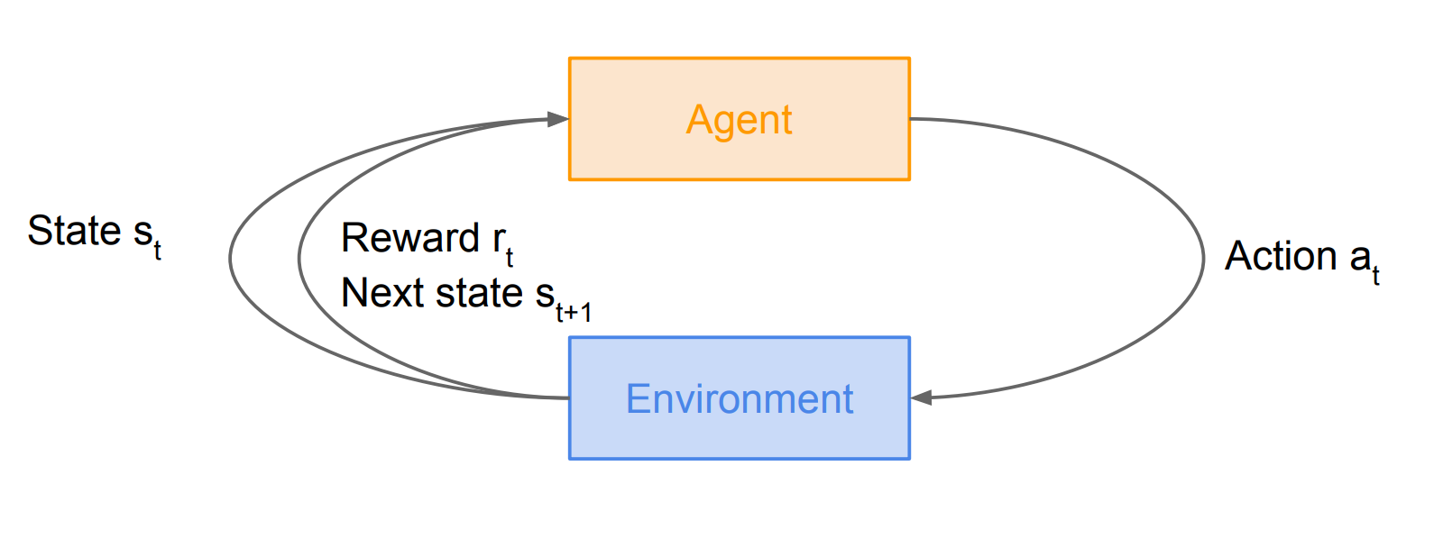
What is reinforcement learning?
Problems: an agent interacting with an environment, which provides numeric reward signals.
Goal: to learn how to take actions in order to maximize total reward.

Slide 8
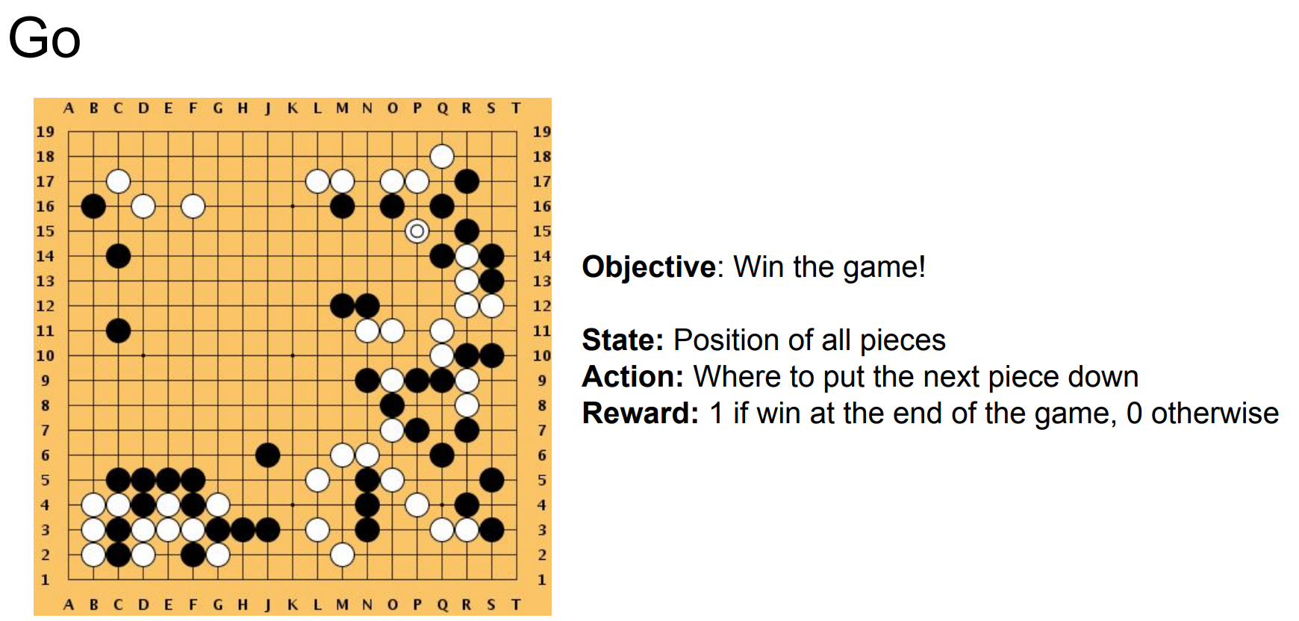
Applications

Slide 9
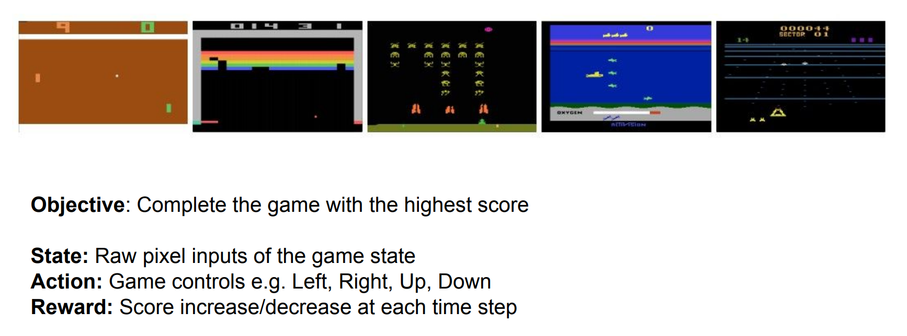
Applications

Slide 10


Applications

Slide 11
Outline for today
Introduction to Reinforcement Learning
Mathematical formulation of RL
Value-based learning, Policy Gradient and the combination
Connections with optimal control

Slide 12
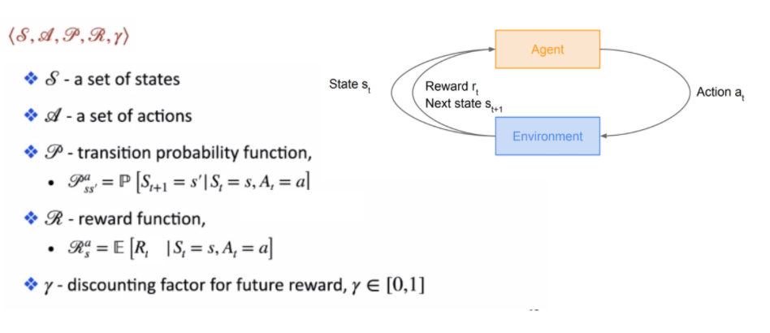
Mathematical formulation of reinforcement learning

Slide 13
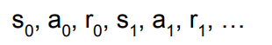
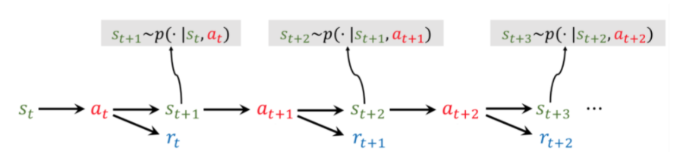
Markov Decision Process
Following a policy produces sample trajectories (or paths)

Slide 14
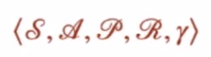
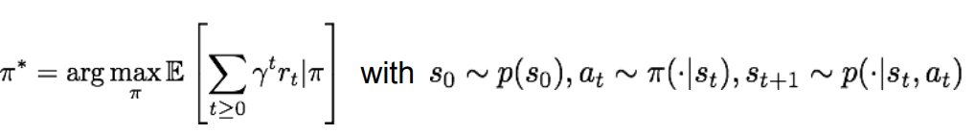
Mathematical formulation of reinforcement learning
Goal: We want to find optimal policy that maximizes the sum of rewards.

Slide 15
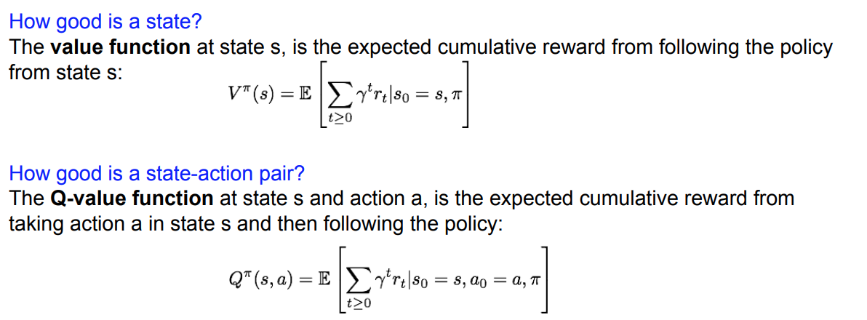
Definitions: Value function and Q-vallue function

Slide 16
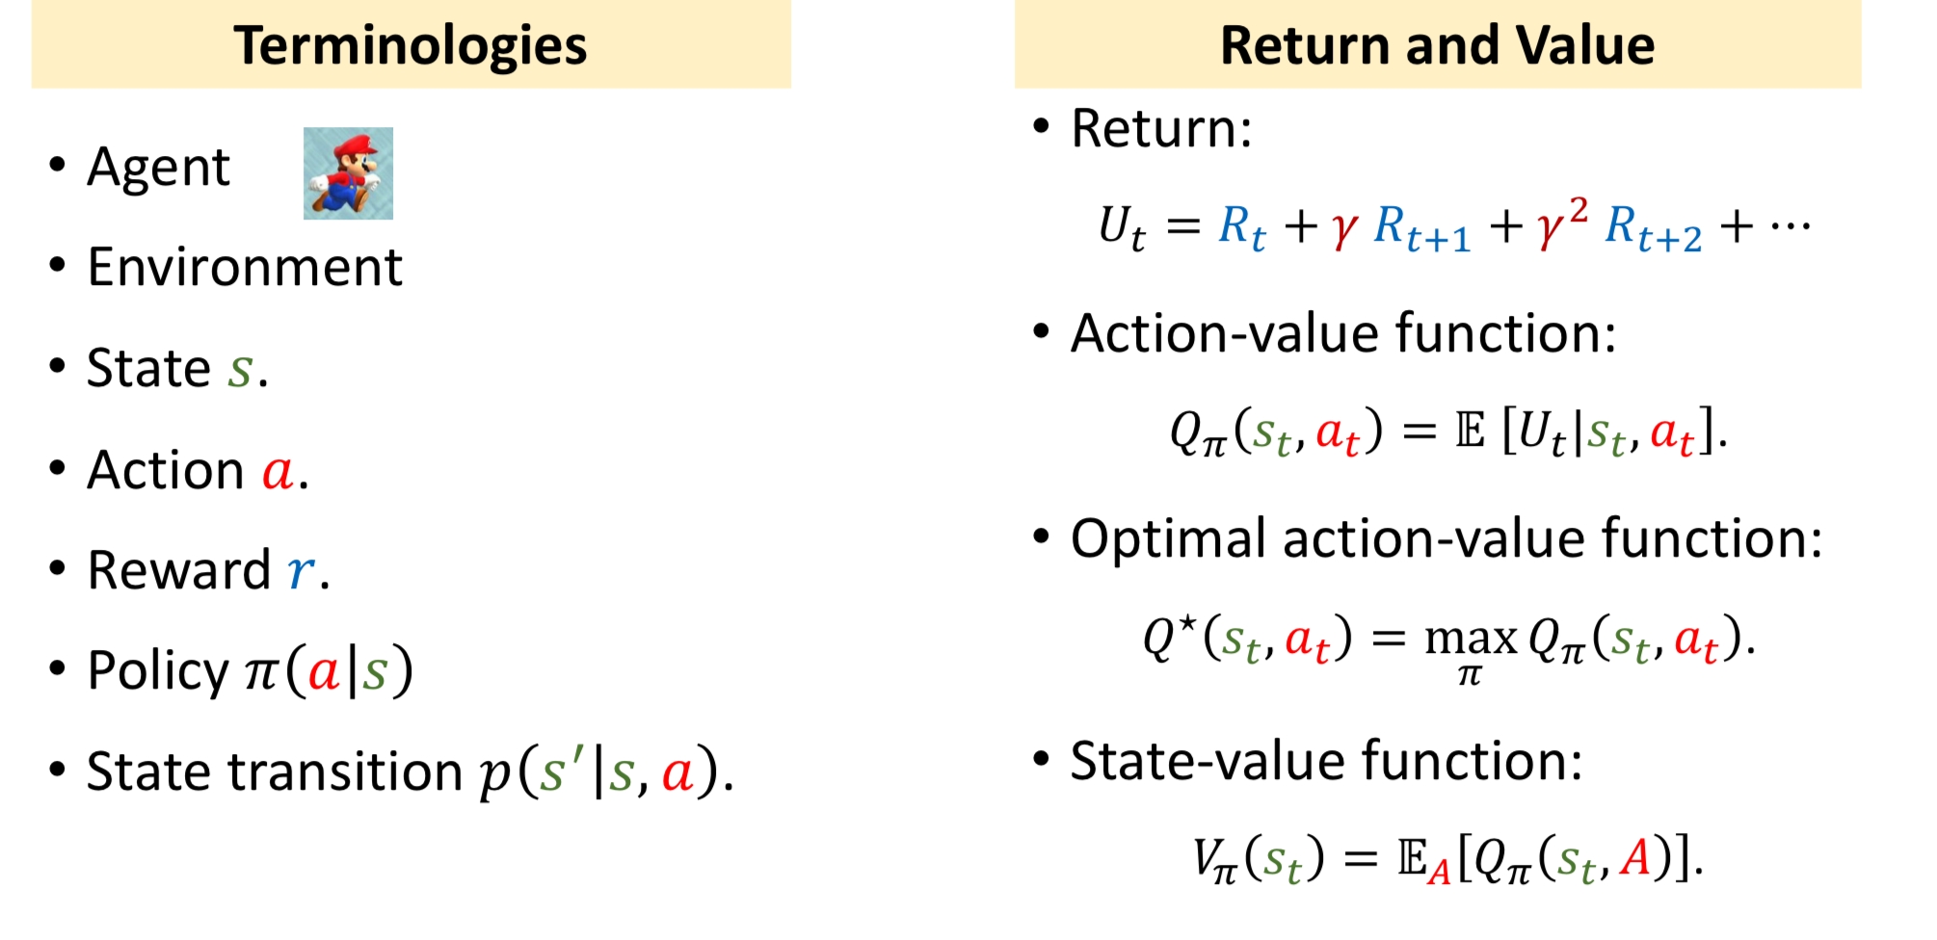
Pause: Summary on notations

Slide 17
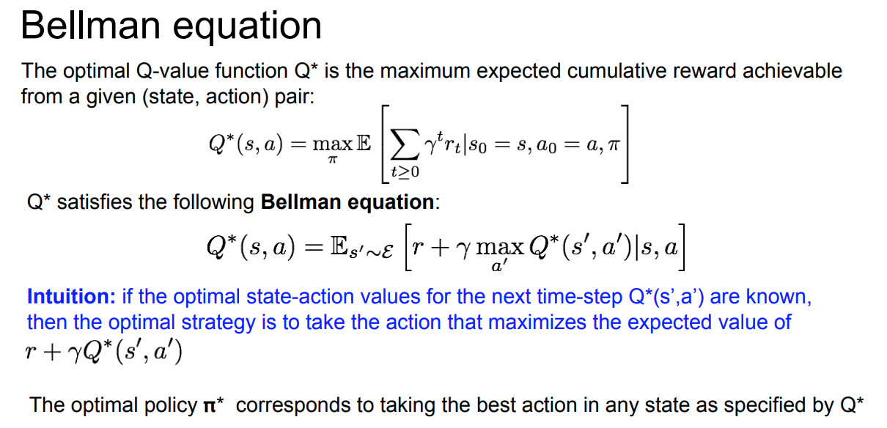

Slide 18
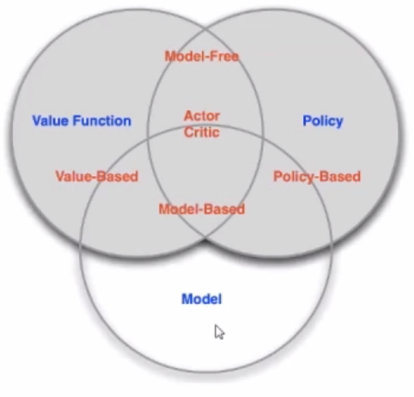
RL agent includes one or more of these components
- Policy: agent's behavior function
- Value function: how good is a state and/or action
- Model: agent's representation of environment
Categorizing RL Agents
Value based: No policy, Value function
Policy based: Policy, No value function
Actor citic: Both policy and value function
Model free: Policy and/or value function, No environment model
Model based: Policy and/or value function, Environment model

Slide 19
Solving for the optimal policy?
Value based method
Policy Gradient method
Both Value and Policy Gradient

Slide 20
Outline for today
Introduction to Reinforcement Learning
Mathematical formulation of RL
Value-based learning, Policy Gradient and the combination
Connections with optimal control

Slide 21
Deep Q Learning

Slide 22
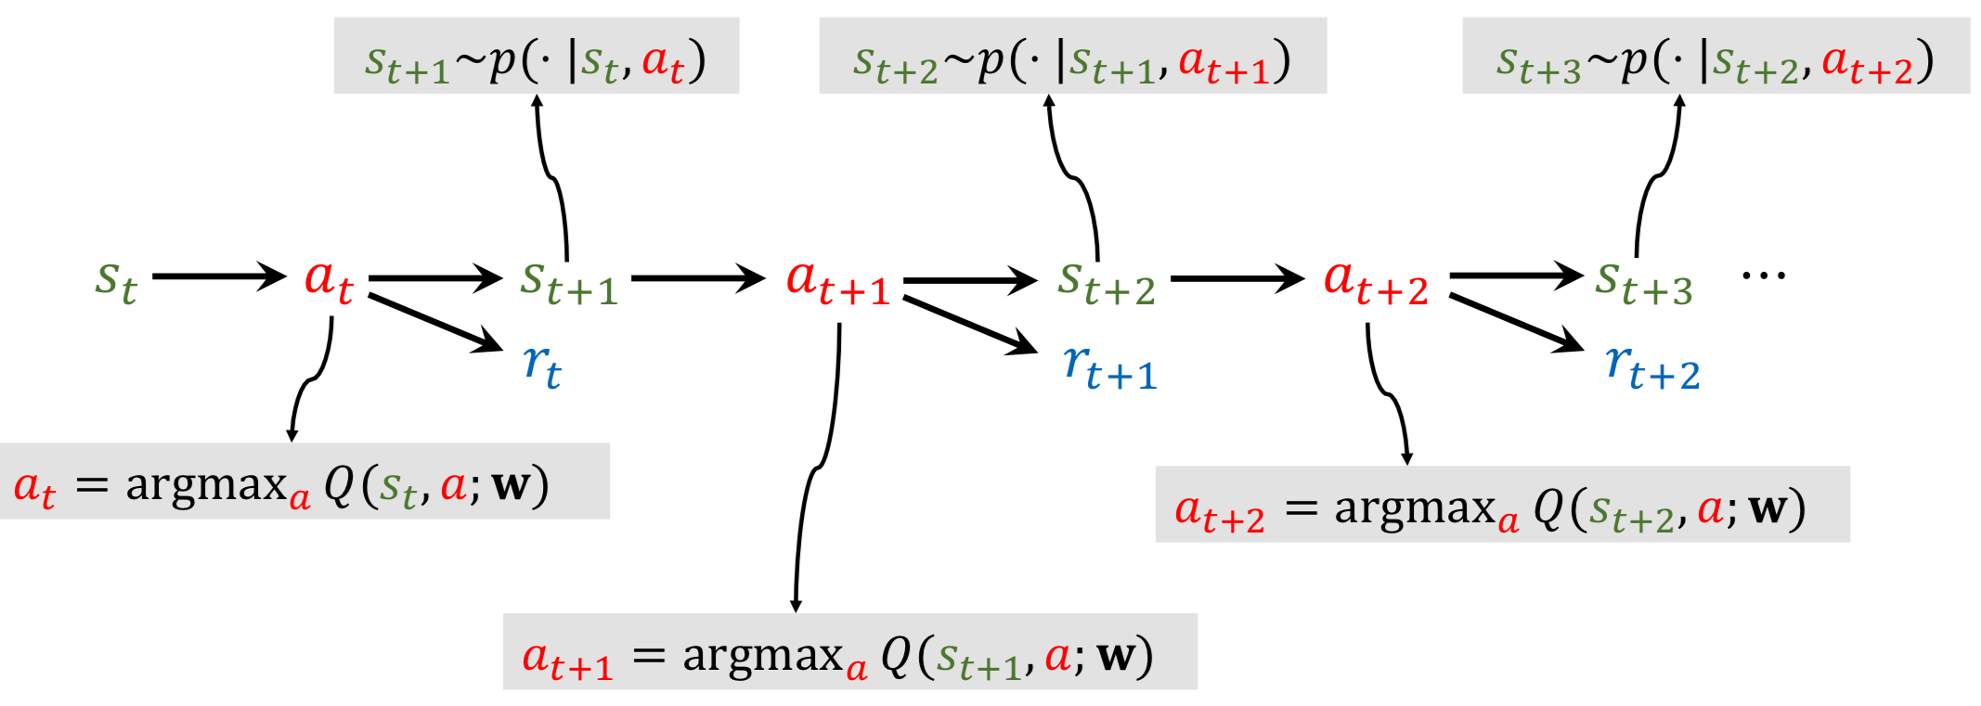
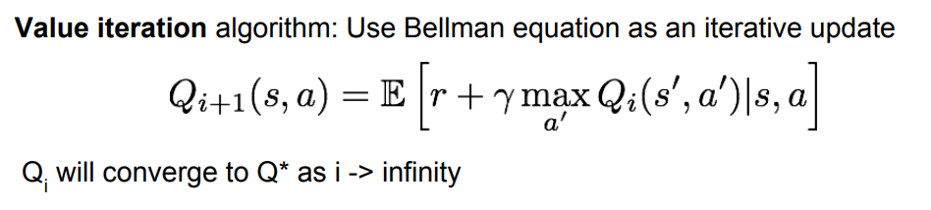

Slide 23
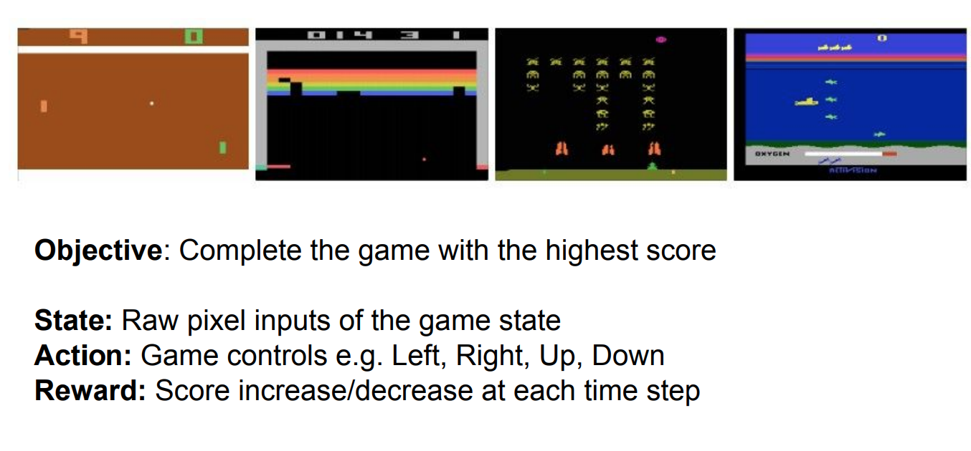
Human-level control through deep reinforcement learning, V. Mnih et al., Nature, 2015.

Slide 24
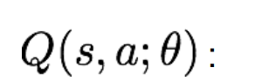
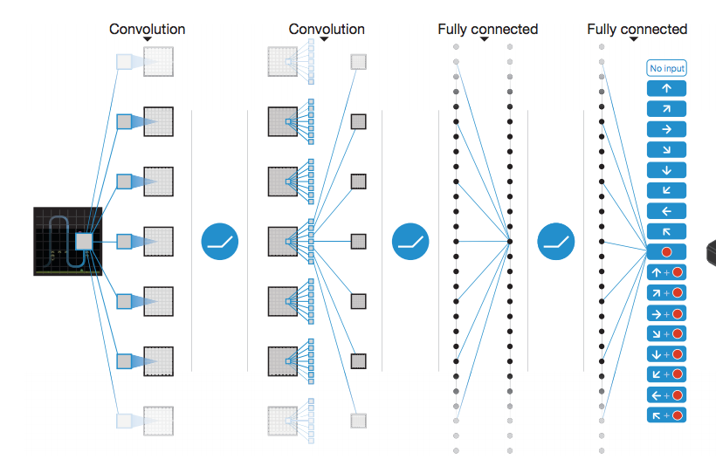
Input: St: 84 * 84 * 4 stack of last 4 frames
Output (depends on games, if 4 actions): Q(st, a1), Q(st, a2), Q(st, a3), Q(st, a4)

Slide 25
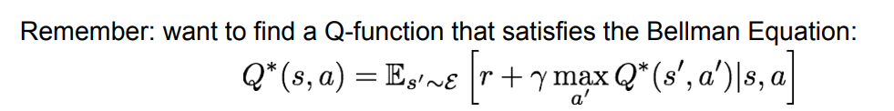
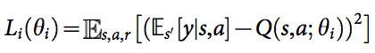
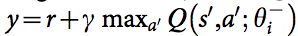
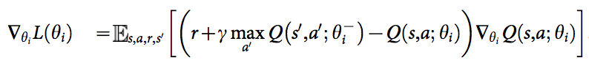
Forward:
Loss
where
Backward:
Iteratively try to make the Q-value close to the target value y, if Q-function corresponds to optimal Q*

Slide 26
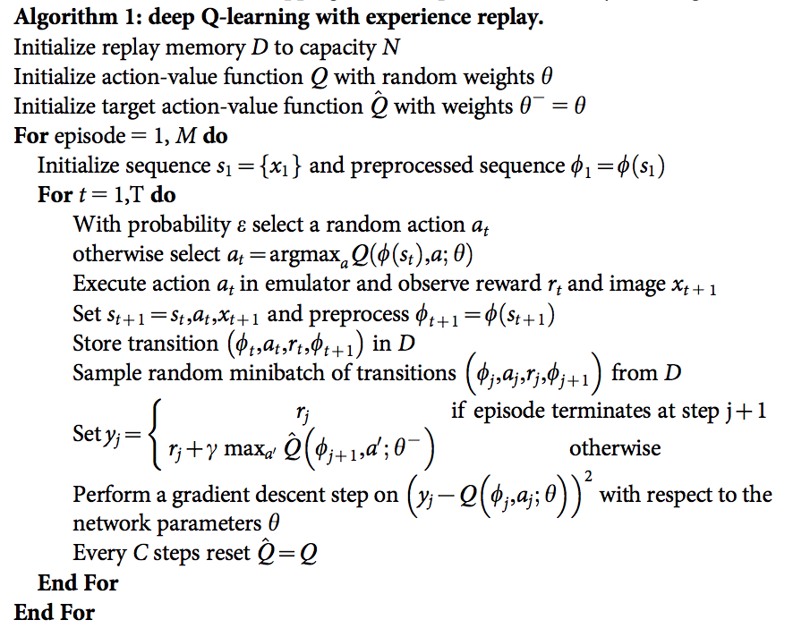
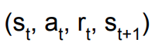
Initialize replay memory, Q-network
Note
Samples are correlated => inefficient learning
Experience replay
Play M full games
Initialize state
Greedy search
Experience Replay: Sample a random minibatch of transitions from replay memory and perform a gradient descent step

Slide 27
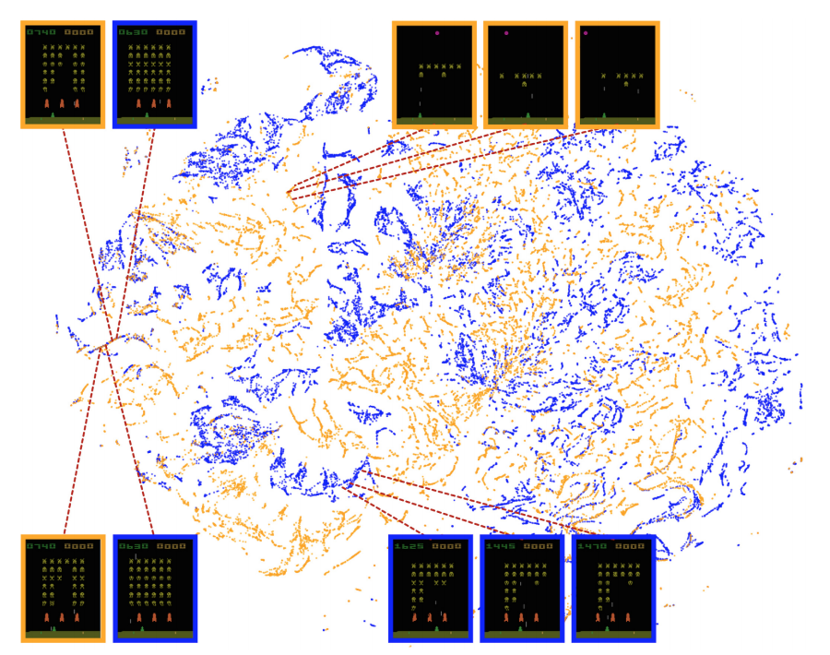
Note:
representations learned by DQN do indeed generalize to data generated from policies other than its own.
The presence in the t-SNE embedding of overlapping clusters of points corresponding to the network representation of states experienced during human and agent play shows that the DQN agent also follows sequences of states similar to those found in human play.
Two-dimensional t-SNE embedding of the representations in the last hidden layer assigned by DQN to game states experienced during a combination of human and agent play in Space Invaders.

Slide 28
Problems with Q-learning:
Discrete action, not continuous
hard to scale to high dimensional state or state-action pairs
More improved algorithm or model versions: Overview of Reinforcement Learning
Can we learn a policy directly,
e.g. finding the best policy from a collection of policies?
Notes:
Value-based RL: David Silver, Richard Sutton, Deepmind
Pocily gradient: Sergey Levine, John Schulman, OpenAI

Slide 29
Policy Gradient:
Pros:
better convergence
Better for high dimension and continuous action space
Stochastic policy
Cons:
local optimal
high variance and slow
Ref:
Policy Gradient Methods for Reinforcement Learning with Function Approximation NIPS 2000, Richard S. Sutton et al.
Deterministic Policy Gradient Algorithms, ICML 2014 David Silver et al.
Continuous control with deep reinforcement learning, ICLR 2016 Lillicrap et al.
Proximal Policy Optimization Algorithms, John Schulman et al. 2017

Slide 30
Policy Gradient

Slide 31
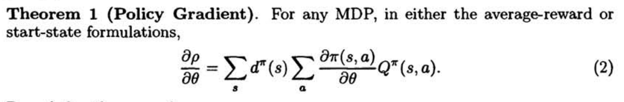
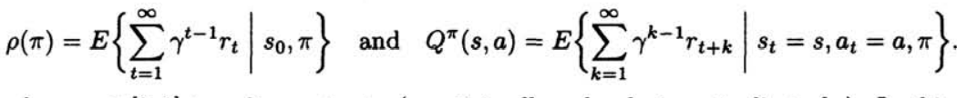
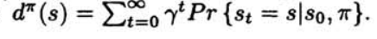
How to update parameters in Policy network?
where
R. S. Sutton et al. 2000

Slide 32
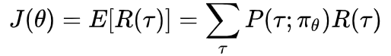
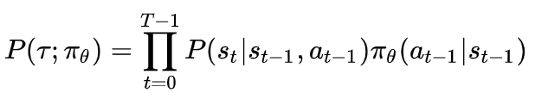
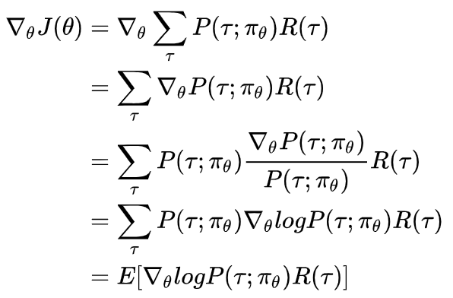
Expected reward:
where
Notes:
Note: P(tau, pi_theta), this is a gradient vector, which is the probability of trajectory where theta changes most;
the bigger R(tau) , the bigger the probability of trajectory selected after updates on parameter theta.

Slide 33
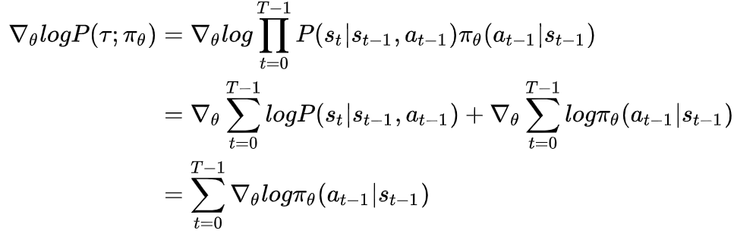
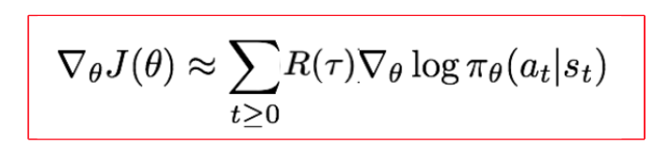
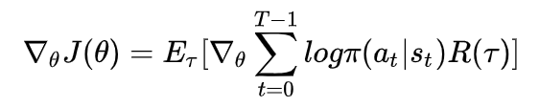
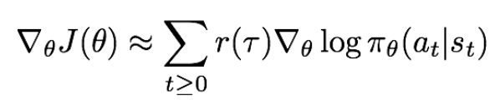
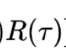
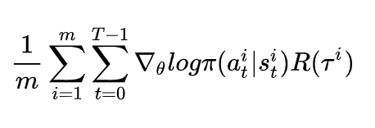
unbiased gradient approximation

Slide 34
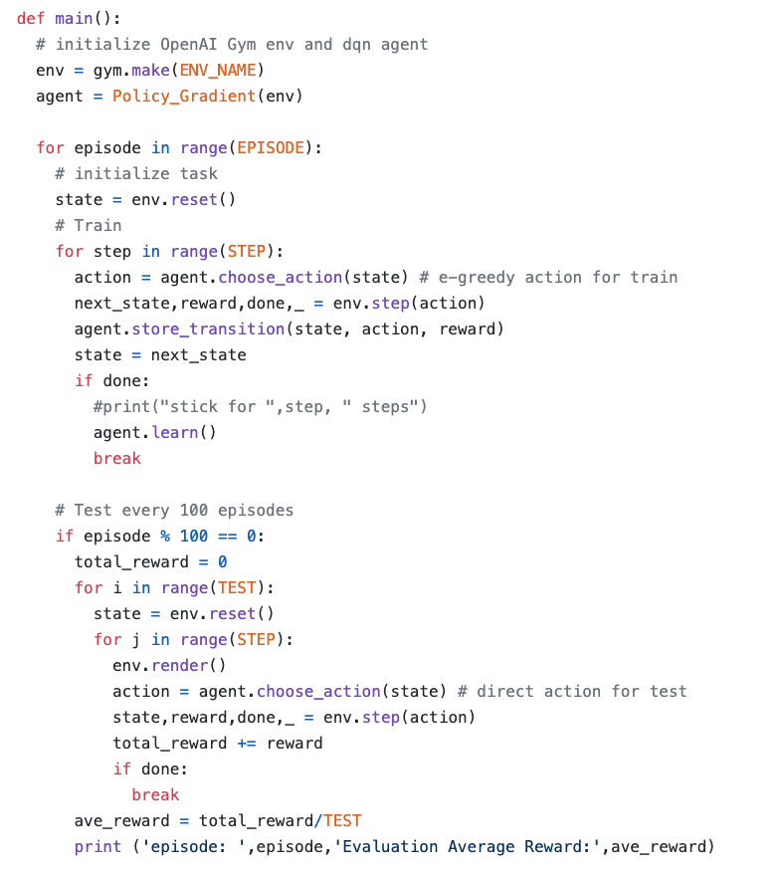
An example:
https://github.com/ljpzzz/machinelearning/blob/master/reinforcement-learning/policy_gradient.py

Slide 35
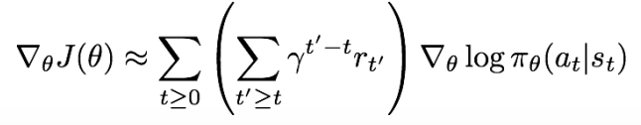
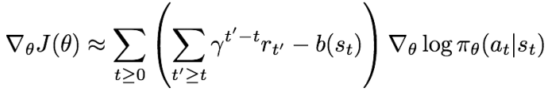
To overcome high variance problem,
1) Push up probabilities of an action seen, only by the cumulative future reward from that state;
2) Use discount factor to ignore delayed effects;
3) The raw value of the trajectory isn't necessarily meaningful, it's important whether a reward is better or worse than what you expect to get. Introduce a baseline function dependent on the state

Slide 36
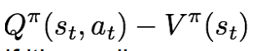
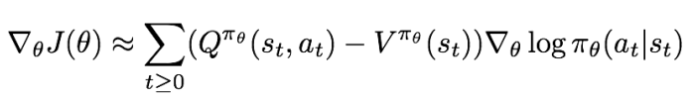
How to choose the baseline?
A simple baseline: constant moving average of rewards experienced so far from all trajectories
A better baseline: Want to push up the probability of an action from a state, if this action was better than the expected value of what we should get from that state.
Q-function and value function!
If is bigger, then more likely to apply a_t at state s_t .

Slide 37
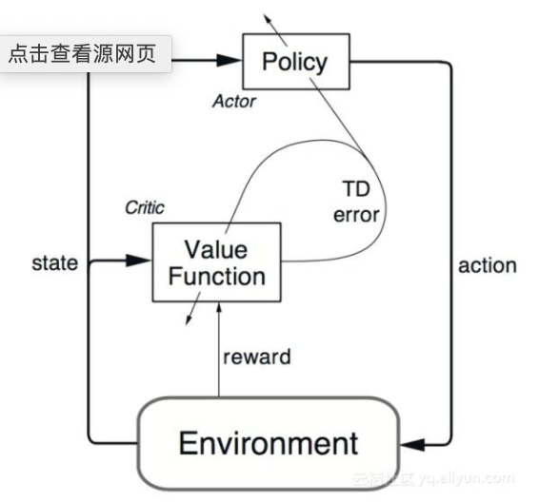
Actor-Critic Algorithm
Note：
Actor Net：state --> action
Critic Net: (state, action) --> Q-value

Slide 38
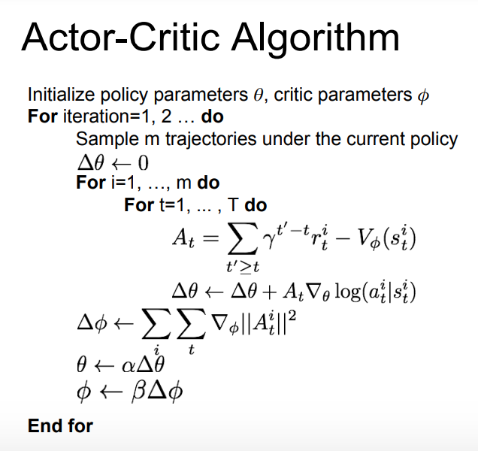

Slide 39
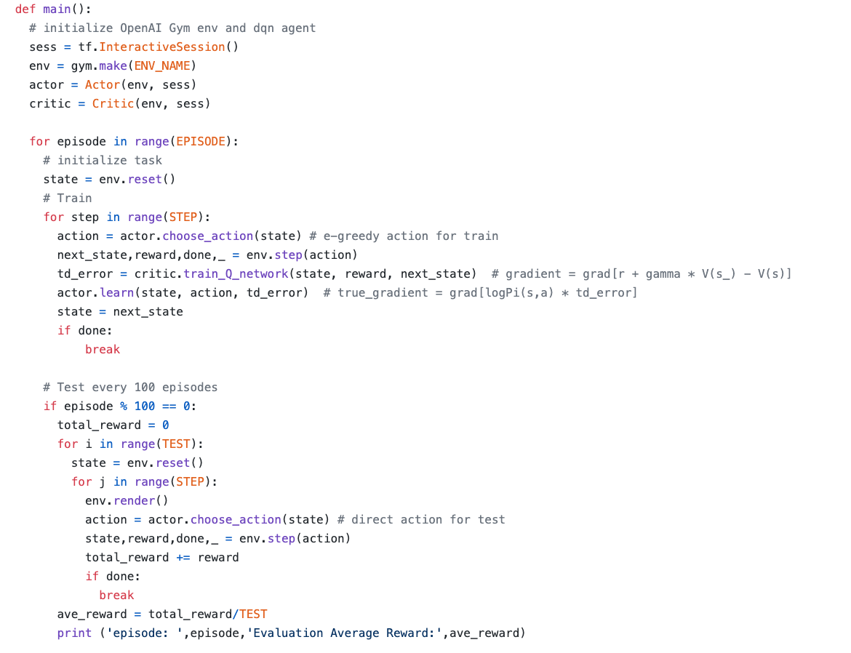
An example:
https://github.com/ljpzzz/machinelearning/blob/master/reinforcement-learning/actor_critic.py

Slide 40
To Be Continue：
DPG
DDPG
PPO
TRPO
A3C...
Model-based Reinforcement Learning

Slide 41
Outline for today
Introduction to Reinforcement Learning
Mathematical formulation of RL
Value-based learning, Policy Gradient and the combination
Connections with optimal control

Slide 42
Comparison between RL and DP
(Reinforcement Learning and Optimal control by Dimitri Bertsekas)
Reinforcement Learning | Dynamical Programing
Reward of a stage | Cost of a stage
State value | State cost
Value function / state-value function | Cost function
Agent | Controller
Action | Control
Environment | Dynamical System
Planning vs Learning distribution | Solving a DP problem with model-based or model free simulation

Slide 43
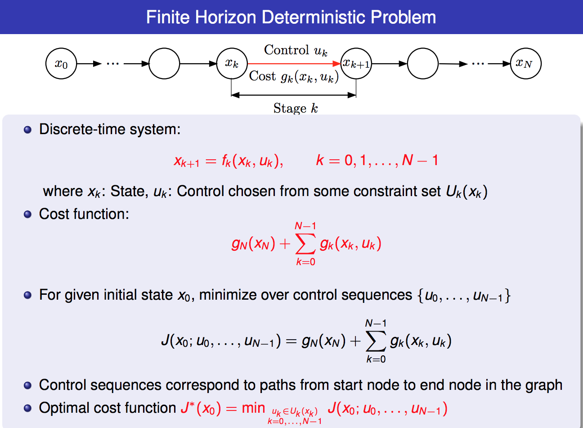

Slide 44
Next：
What's the relation of the methods of control theory with the algorithms in RL?
Pontryagin's maximum principle，PMP
Hamilton-Jacobi-Bellman(HJB)

